Slide 1
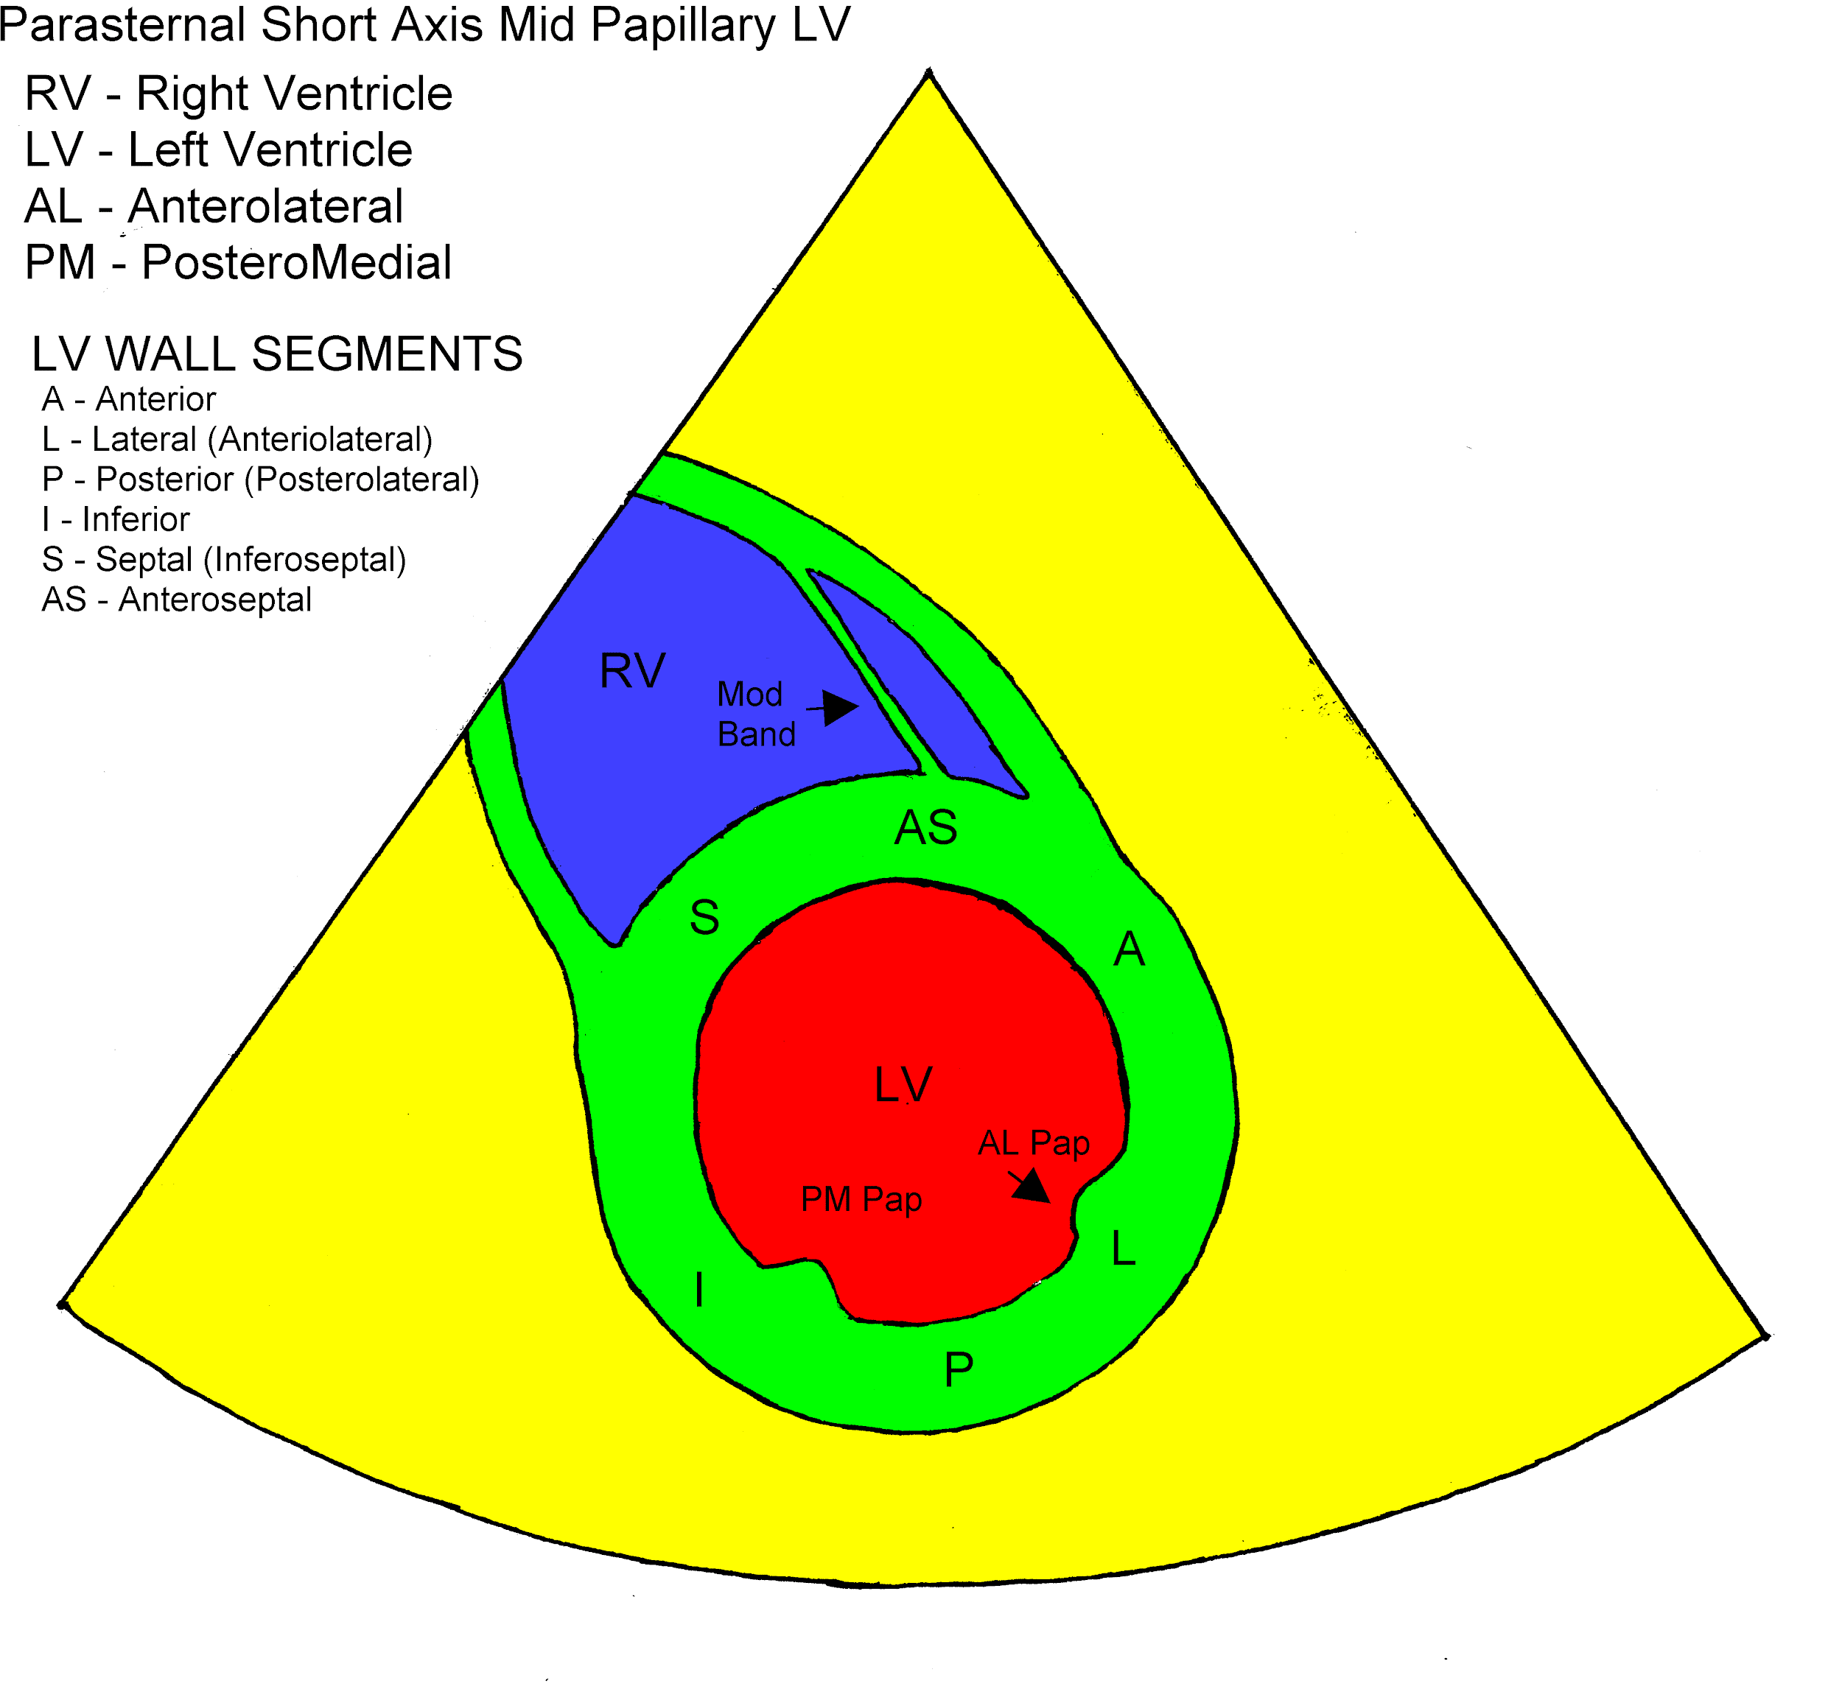
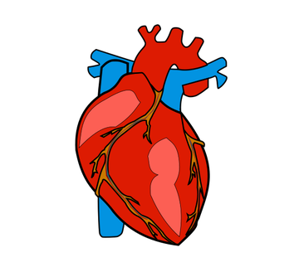
Overview
Medical image segmentation is an important feature of modern medicine.
Segmentation of the left and right ventricles of the heart are crucial for the timely diagnosis and treatment of cardiovascular disease.

Slide 2
Review of existing work
In the paper Deep Learning for Cardiac Image Segmentation: A Review by Chen et al., they state that FCNs and UNets are the default architecture for medical segmentation.
They also describe how using prior information about the heart improved results.
In the term project paper Cardiac MRI Image Segmentation for Left Ventricle and Right Ventricle using Deep Learning by Seo et al., they describe how they implement a similar architecture.

Slide 3
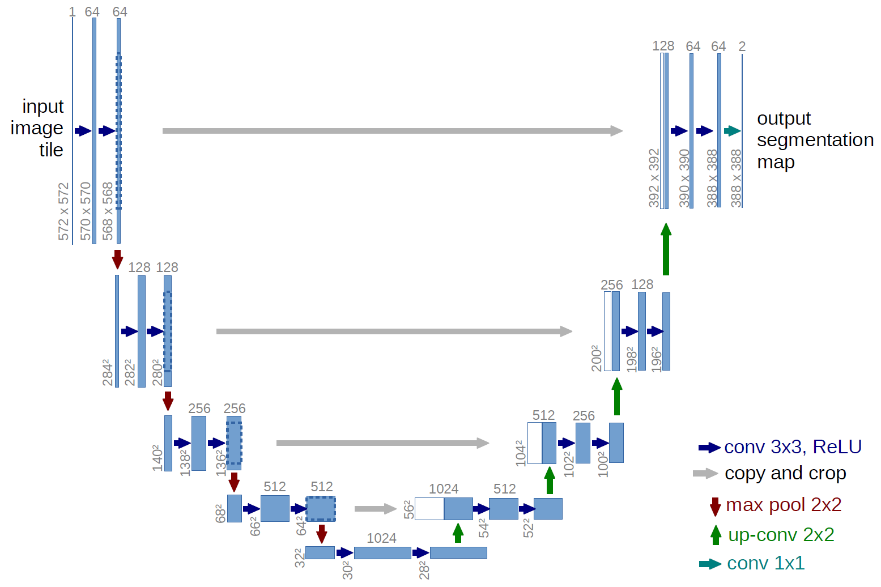
Approach
The first step of the process wa preprocessing all the data (from the ACDC dataset) to be images of uniform size of 256x256.
The UNet takes in the single feature image and convulves it to a 16x16 image with 256 features. It then convulves it back to a 256x256 image, with 4 feature (to represent class).
In the UNet, each convolution that is not increasing/decreasing the image size is a the 3x3 convolutions, each followed by a ReLU activation.

Slide 4
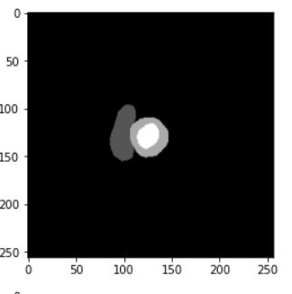
Approach
A cross entropy loss was used as the loss function for the UNet.
In order to incorporate priors, a weighted cross entropy loss was used.
The weights were chosen as follows:
Class 0: Weight of 0.1, as this class is both the least important and takes up the most space the risk of misclassifying is very low.
Class 1 and 2: Weights of 2.0, as these classes have a high risk of being misclassified.
Class 3: Weight of 1.75. This number has been found through tuning, as it tends to over take the other classes.
0
1
3
2

Slide 5
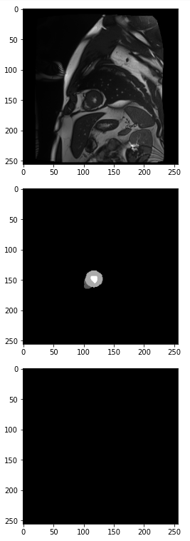
Results and Discussion: Unweighted loss
After training on 400 epochs, the network produced a loss of 0.15300 on the test dataset. Despite this, the outputted result is a black screen.
This makes sense, as the background class makes up most of the image. By predicting 0 for each pixel, the majority is predicted correctly. This will produce low errors no matter what.

Slide 6
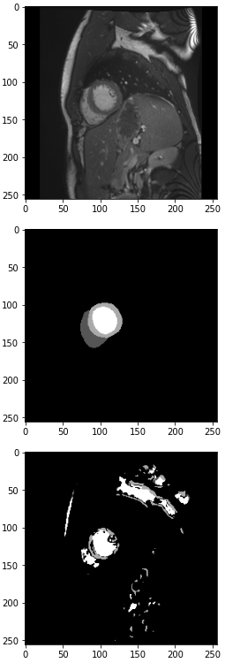
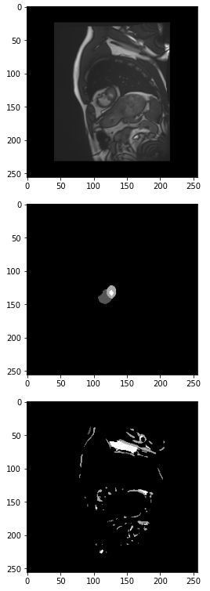
Results and Discussion: Weighted loss
With weighted loss trained on 400 epochs, the network produced a test loss of 0.36224. Despite this I consider it to be better result, as now the shape of the ventricles start to show up.
Unfortunately, there are many artifacts in the predictions, and class 1 does not often show up as predominantly as it should. Some images that seem to have slightly different shading don’t predict anything, perhaps because of poor normalization.

Slide 7
Conclusion
While the incorporating prior information into the loss function has produced results, it is far from perfect. There are still much work to be done to get better results. Here are several options for future work:
More precise tuning and selection of weights.
Better tuning of optimizer parameters.
Training on more epochs.
Creating a custom loss function to take in more prior information.

